Slide 1

Walsh & Indiantown Property Holdings, LLC
Large-Scale Comprehensive Plan Amendment
No. CPA 24-009
Village of Indiantown, Florida
Village Council Meeting 5-9-2024

Slide 2
Applicant Request
Applicant request by Joseph W. Walsh & Indiantown Property Holdings, LLC for approval of approval of a large-scale comprehensive plan amendment for the 116.16-acre subject property from Rural Density future land use designation to Commercial Waterfront future land use designation.

Slide 3
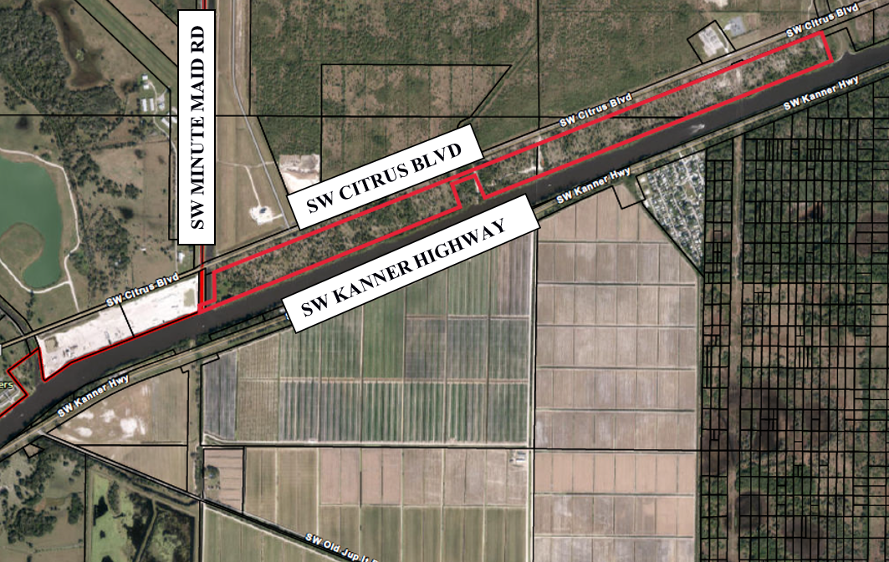
Property Location
Location: south of SW Citrus Blvd. north of SW Kanner Highway and east of the existing Village of Indiantown municipal boundary.
PCN: 03-40-39-000-000-00030-2
02-40-39-000-000-00050-9
35-39-39-000-000-00040-4
Acreage: 116.16-acres

Slide 4
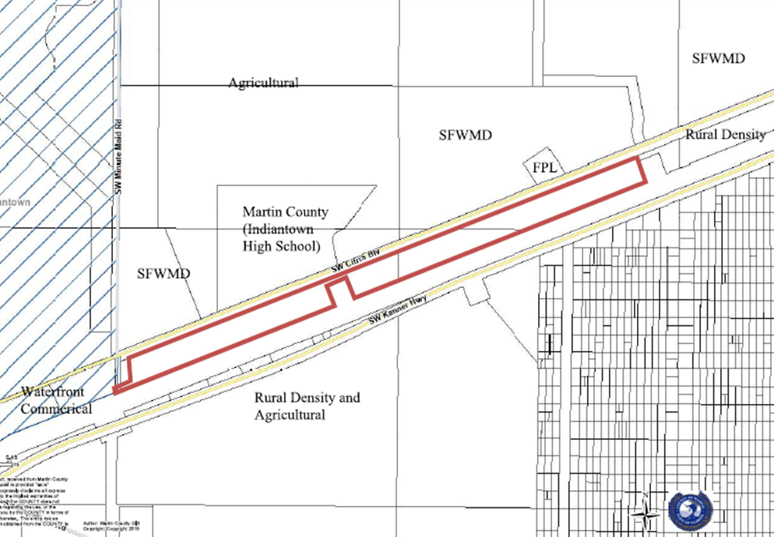
Municipal Boundary - Proposed

Slide 5
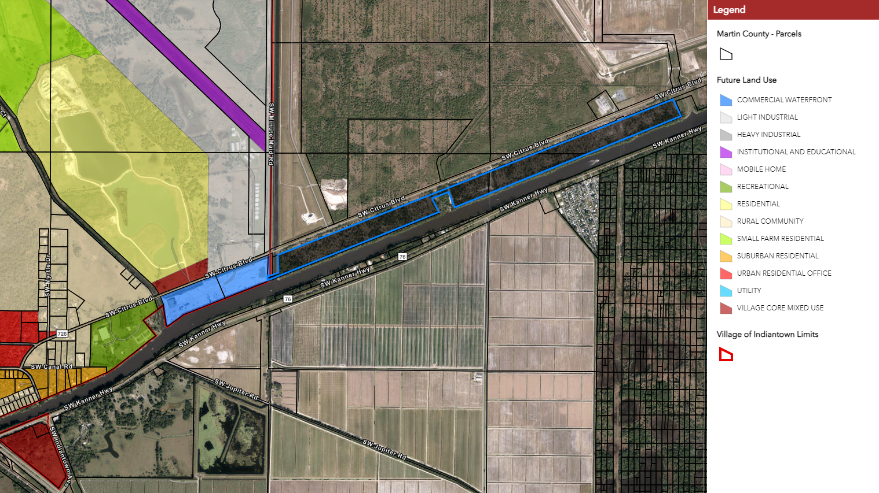
Existing Land Use – Village

Slide 6
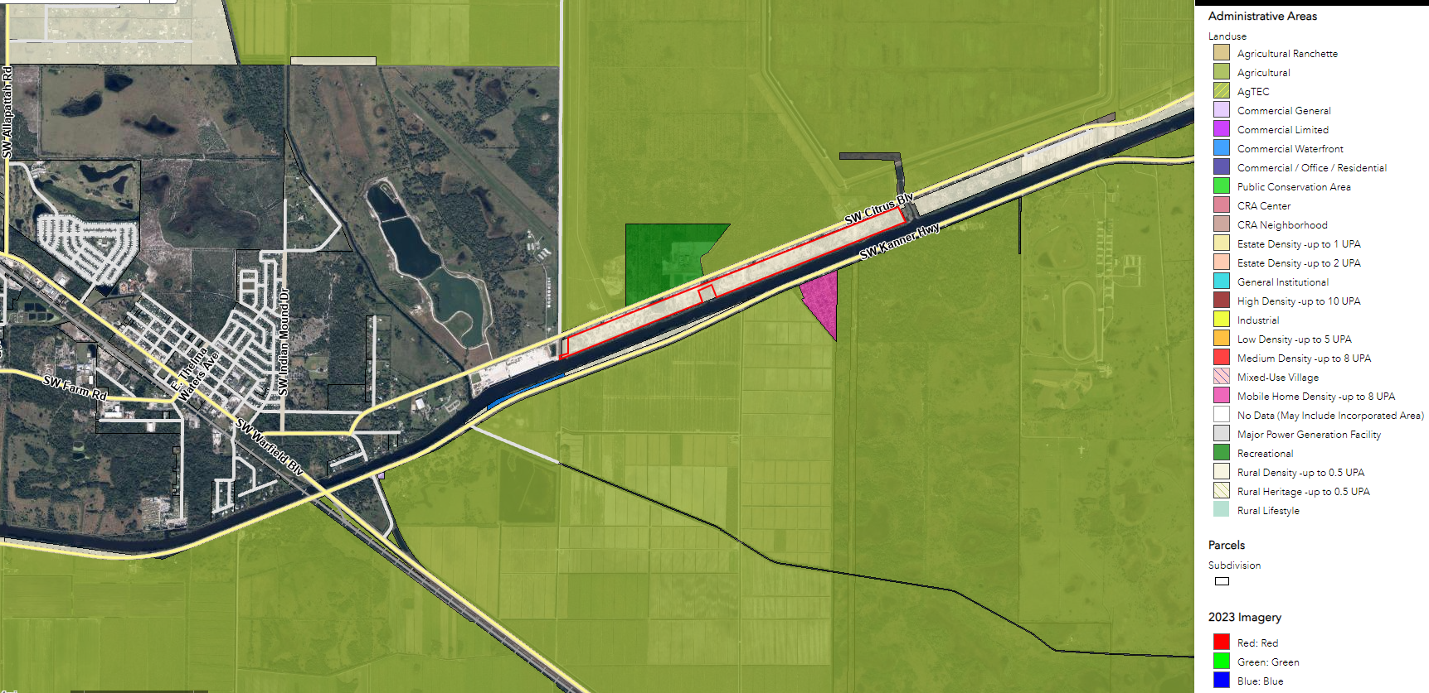
Existing Land Use – Martin County

Slide 7
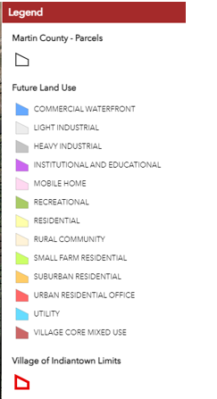
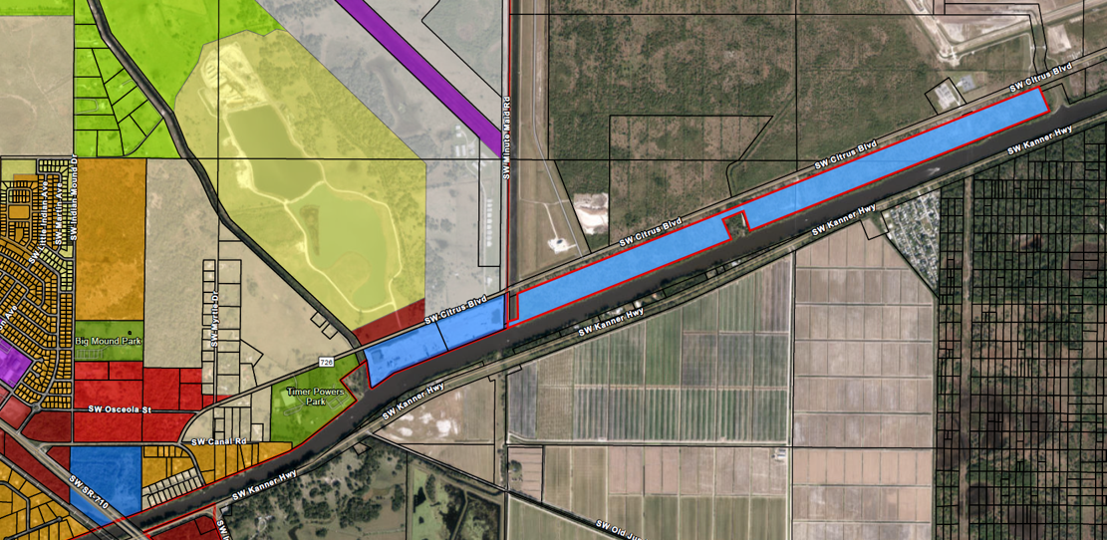
Commercial Waterfront
Proposed Land Use
COMMERCIAL WATERFRONT

Slide 8
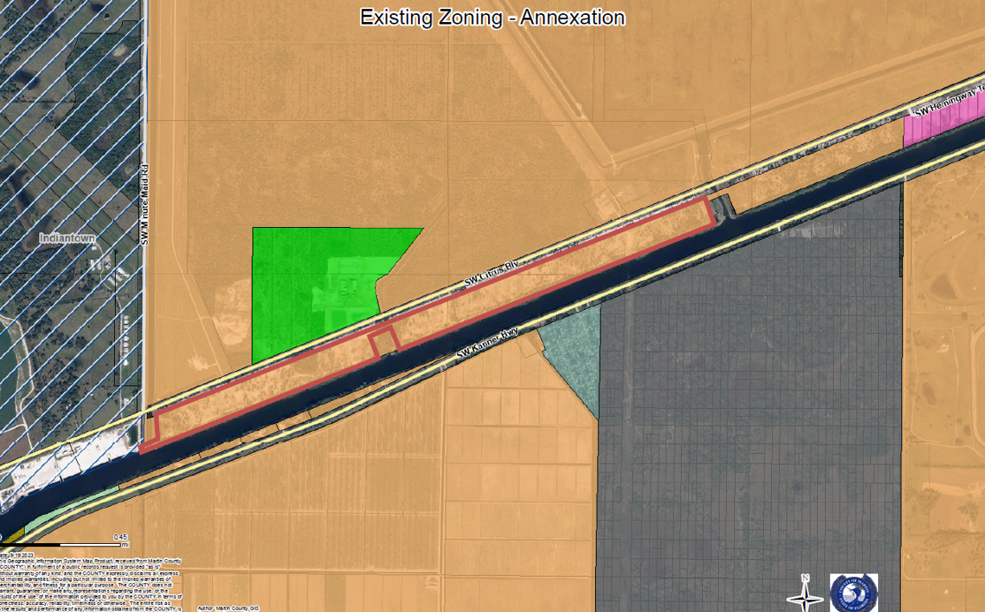
Existing Zoning – Martin County
A-2
RE-2A
A-2
VILLAGE
OF
INDIANTOWN
PR
A-2
PR
TP
A-2
A-2
IZ
A-2

Slide 9
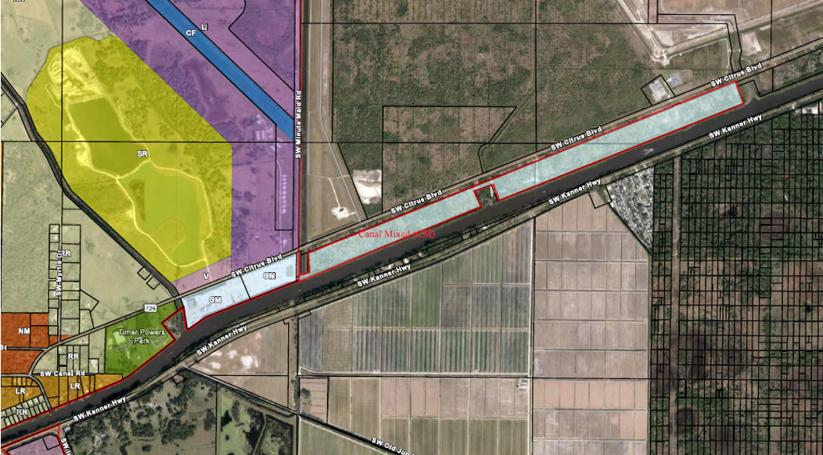
Proposed Zoning
CANAL MIXED USE
CANAL MIXED USE

Slide 10
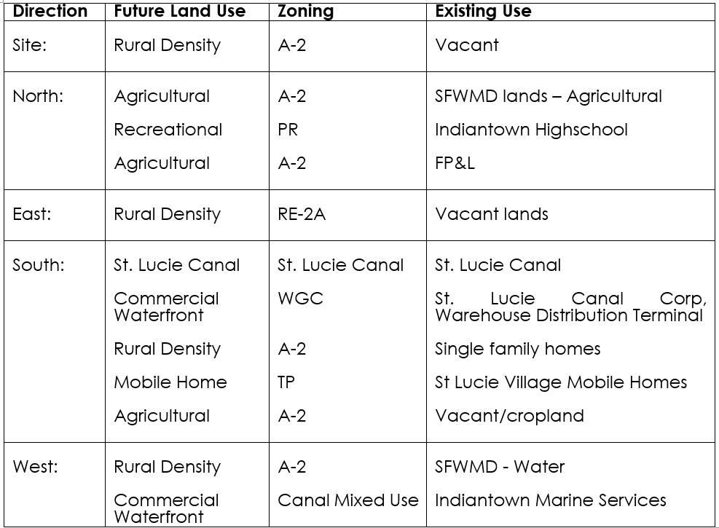

Slide 11
Large-Scale CPA Review Process
Intake & Completeness
Staff Review
Comp Plan
PZAB public hearing
Village Council Public Hearing(s)
& Consultation Process
LDRs
Application submitted by the Applicant
PZAB Review as LPA
Review
Recommendation to Village Council
VC Public Hearing # 1: Consider PZAB/LPA recommendation
F.S. §§
Recommendation
Public Hearing
Amendment becomes effective.
30-day Consultation
VC Public Hearing # 2
Transmittal to the State

Slide 12
Large Scale CPA Review
Approval Evaluation Criteria
This application was reviewed for compliance with the Village Land Development Regulations (LDRs). Submittal requirements for a Comprehensive Plan map amendment are included in Sec. 12-4. (3). The Applicant has satisfied the requirements of the LDR provisions. Pursuant to Sec. 12-4. – Comprehensive Plan text and map amendments and subsection (4) Procedure and Florida State Statue F.S. §§ 163.3184 as a Large-scale comprehensive plan amendment.

Slide 13
Large Scale CPA Recommendations
Village Staff recommends approval of Application No. CPA-24-009 for the Large-Scale Comprehensive Plan amendment to change the future land use map from Rural Density to Commercial Waterfront.
The PZAB considered the request at a public hearing held March 7, 2024, and recommended approval.
The Village Council considered the request at a March 14, 2024 public hearing and recommended approval.
Consultation was undertaken with applicable third parties in accordance with the 2023 Florida Statutes ss.163.3184. and LDR Sec. 12-4. Comprehensive Plan text and map amendments.
The Village Council is now requested to make a final decision on the request.

Slide 14
QUESTIONS?

